Slide 1
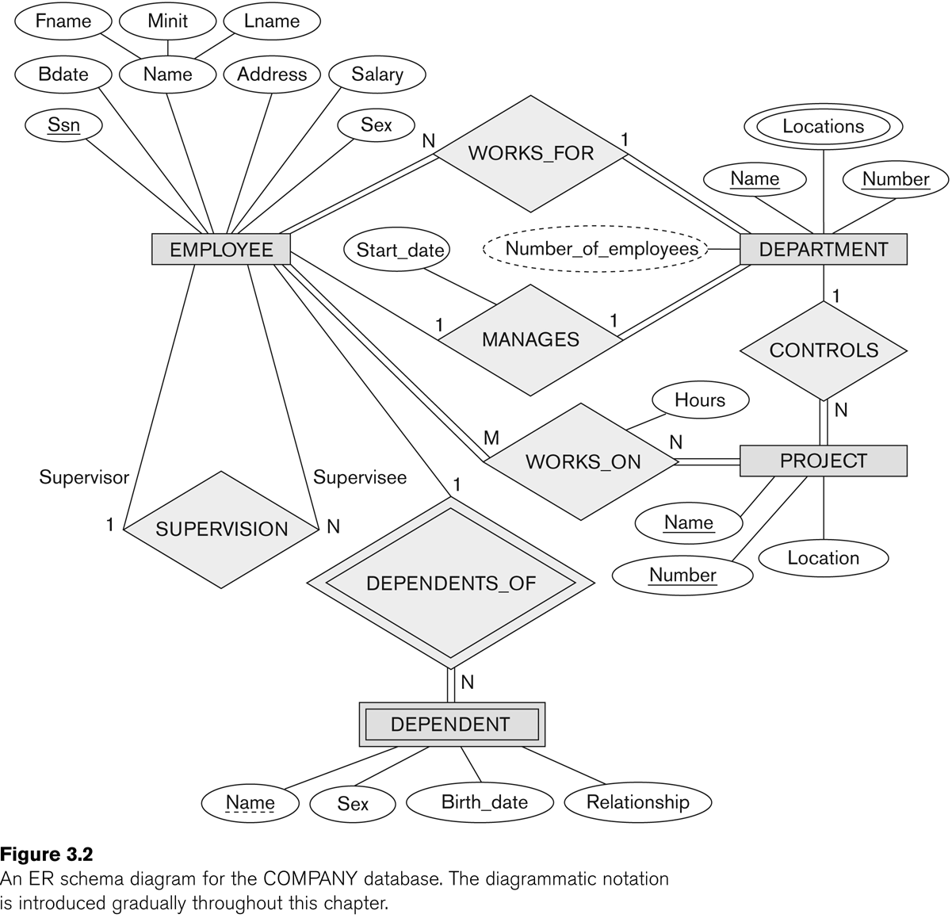
ER (Entity Relationship) Diagram in Chen Notations
Entities - objects or items of interest
Attributes - facts about, or properties of, an entity
Relationships - links between entities
References
Modeling Using the Entity–Relationship (ER) Model (chapter 3, Fundamentals of Database Systems by Elmasri)
https://vertabelo.com/blog/chen-erd-notation

